Slide 1
Team members:
Raghav Khanna
Sahil Mattoo
Dharmil Shah
Prasad Pathak
Parag Khankhari
Sarvesh Sawant
Yathish reddy
Sathwik
Dhruv Parmar
Swini Rodrigues

Slide 2
Programming principles used:
User-Friendly Actions Interface – GUI
API Creation – Used Abstraction, polymorphism, inheritance
Organized the code using the Model-View-Controller (MVC) structure
SOLID design patterns are used
Managed data effectively by populating CSV files.
Singleton Factory design pattern

Slide 3
Functionalities:
User-Centric Role Management: We implemented a user-friendly role functionality with three types: Admin, Student/Parent, and Teacher.
Comprehensive Immunization Management: We enabled users to perform CRUD operations on Immunization Info, managing fields like Immunization Anniversaries.
Alert System for Immunization: We implemented an alert system displaying vaccination due dates and renewal information.
Teacher Rating System: Provided a feature for students/parents to give ratings to teachers.
GPA Assignment by Teachers: Empowered teachers to assign GPA to their students.
Adherence to State Regulations: Students are assigned to teachers in compliance with state regulations.
Tech Stack: Implemented the system using Swing for the UI, CSV for the database, and Java SE as the programming language.

Slide 4
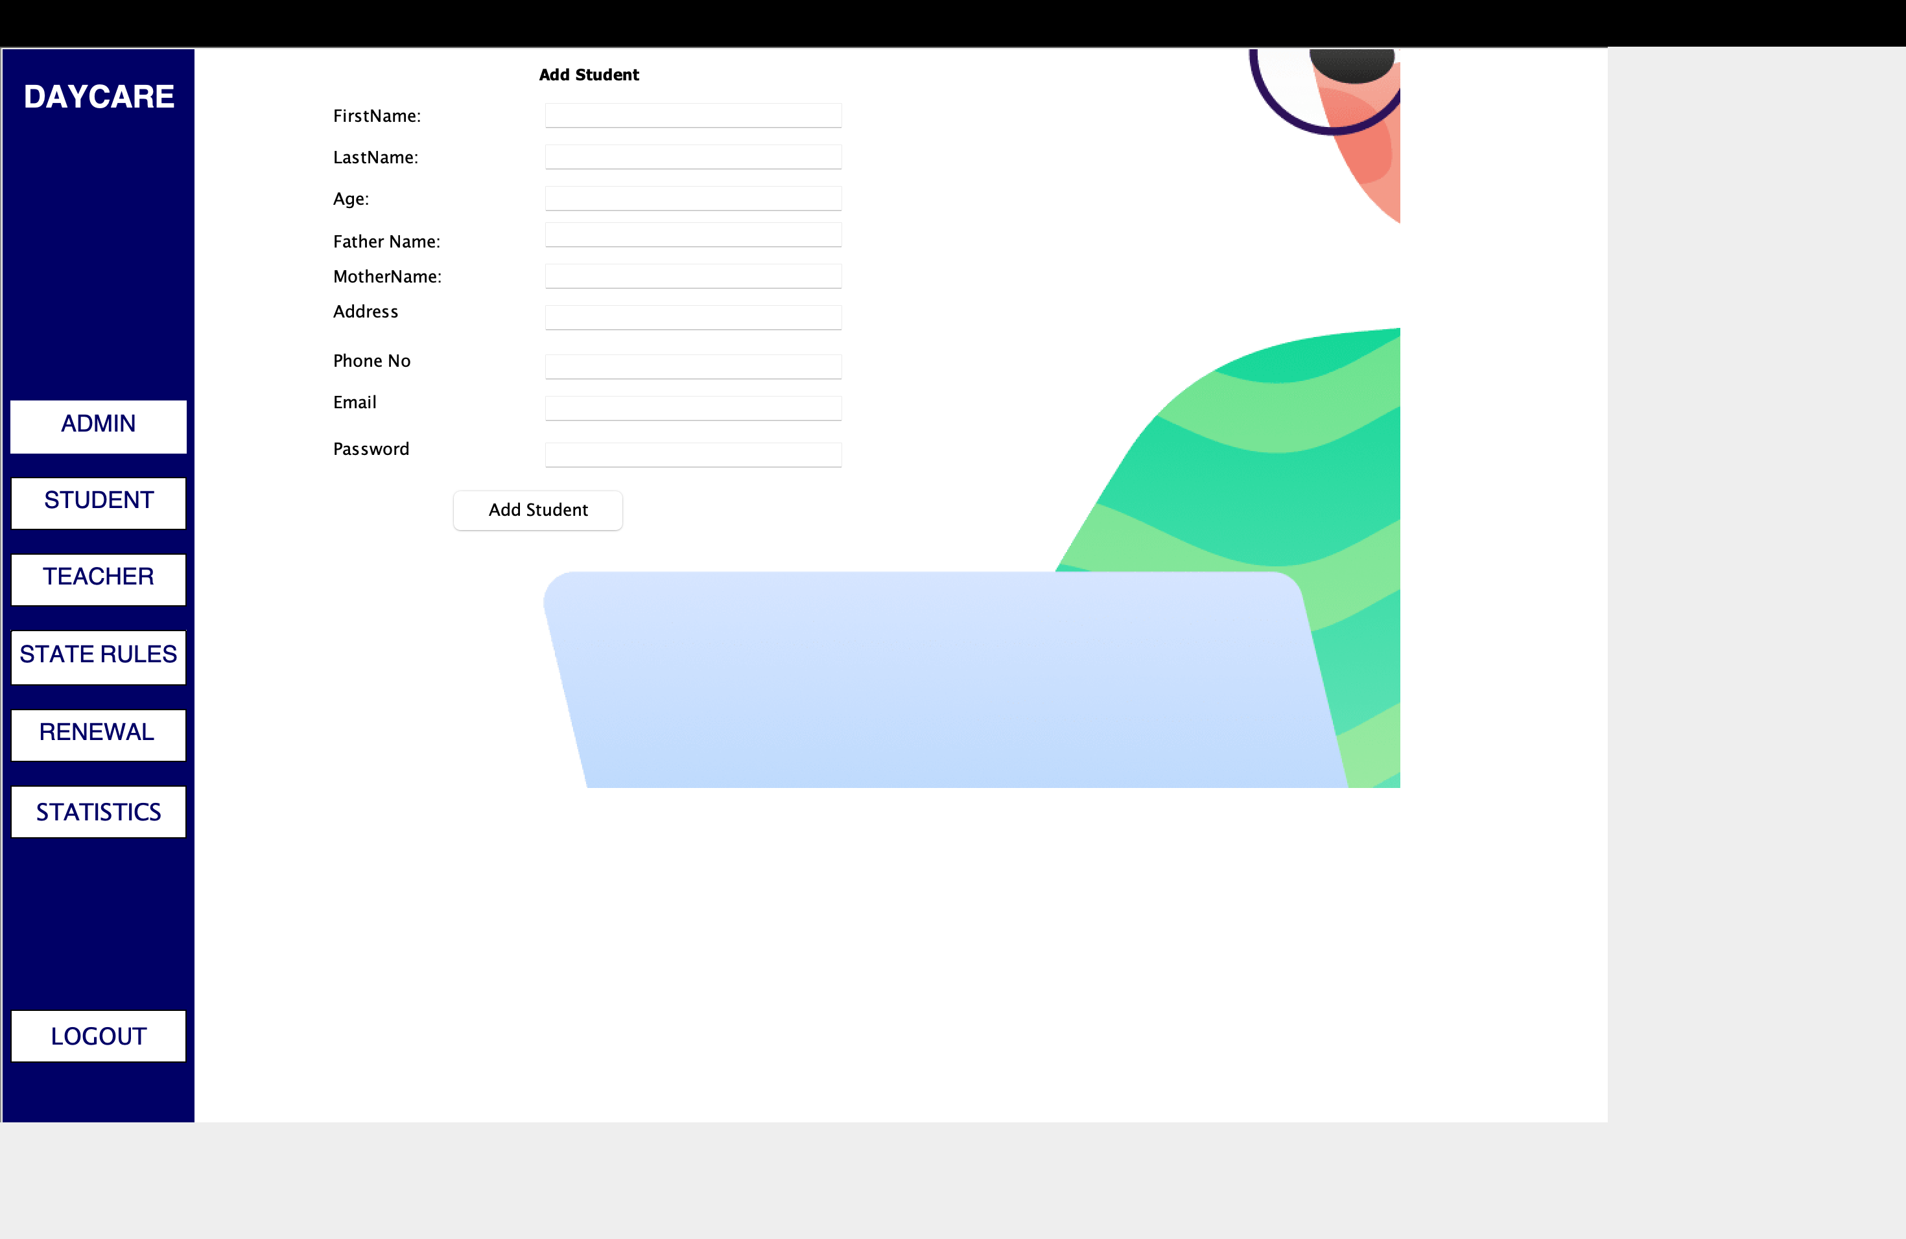
Here, we add students to the database

Slide 5
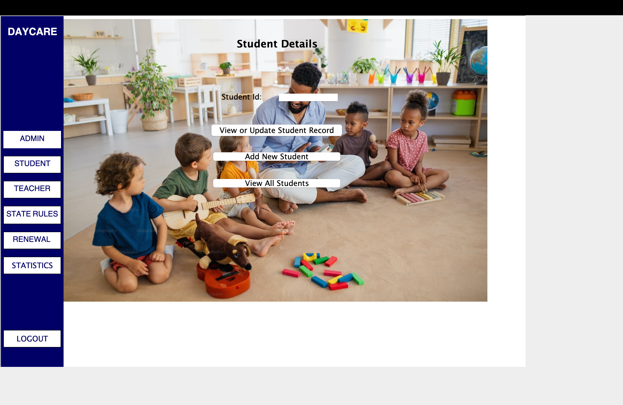
We can add student ID to check their details

Slide 6
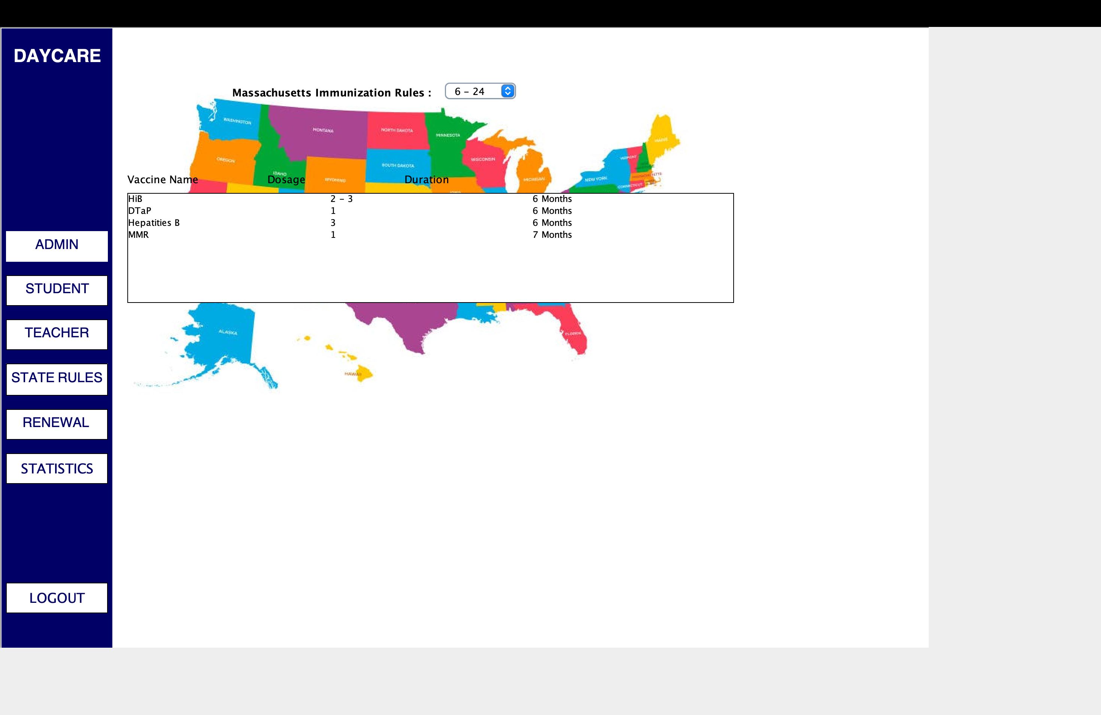
These are the state immunization rules

Slide 7
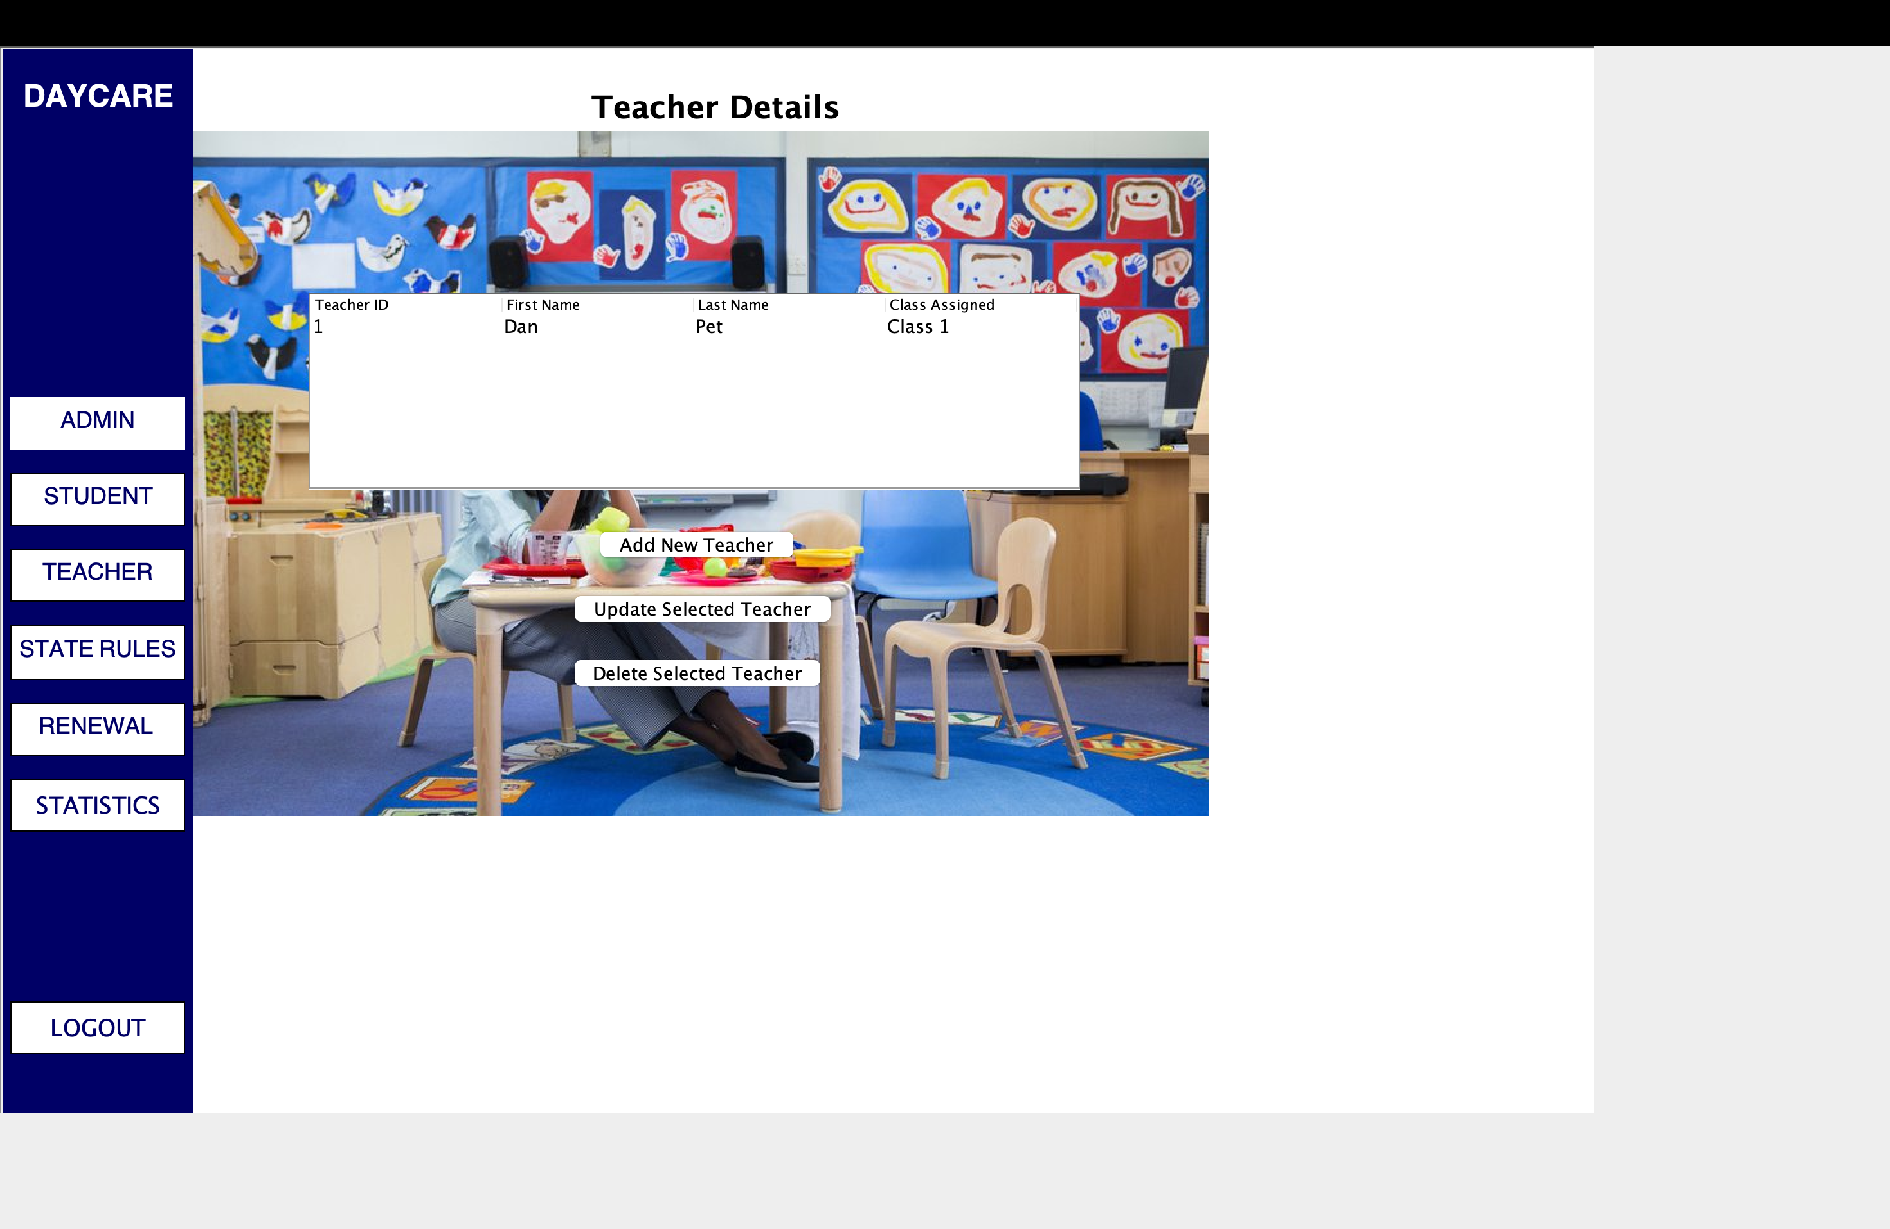
We can add, update and delete teachers

Slide 8
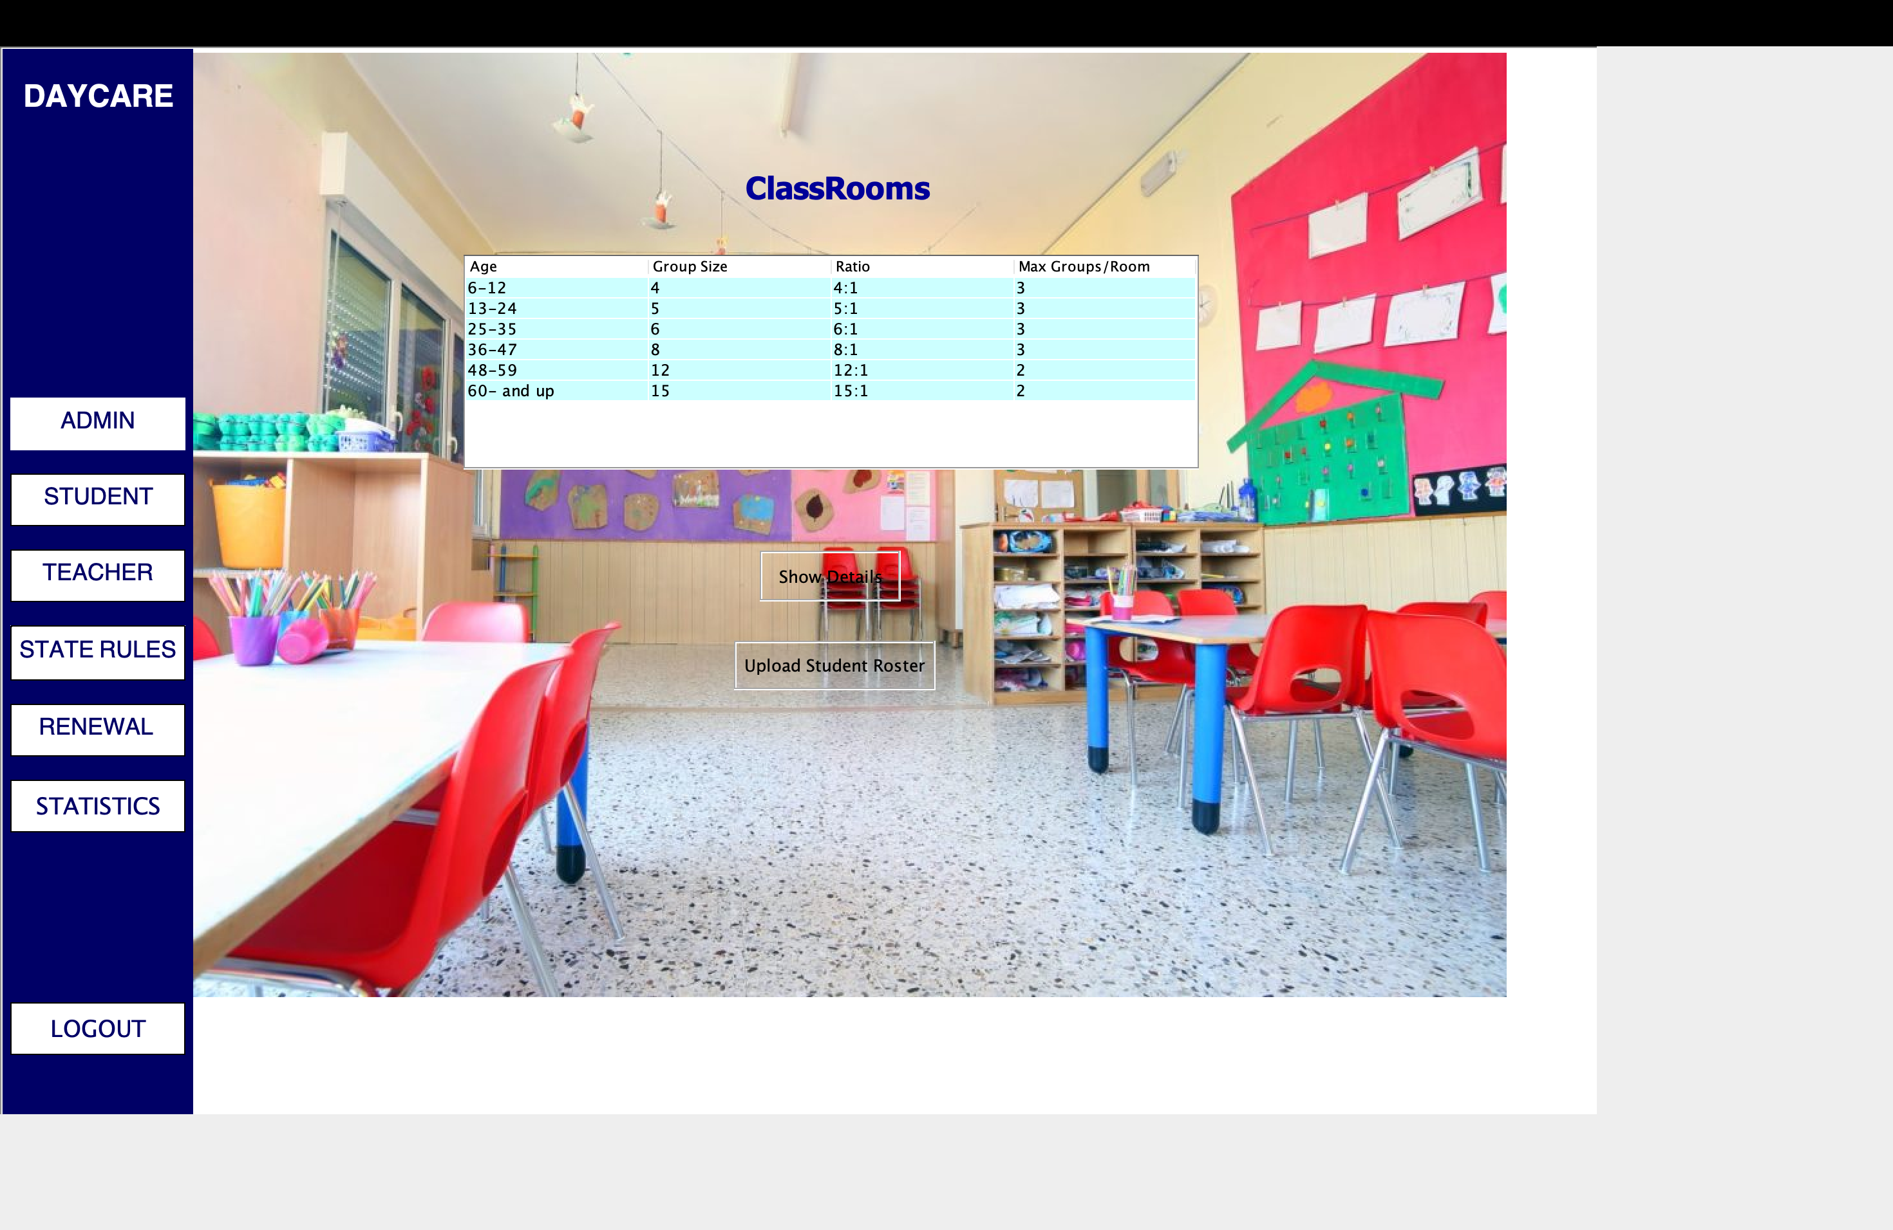
These are the classroom rules and an option for uploading students

Slide 9
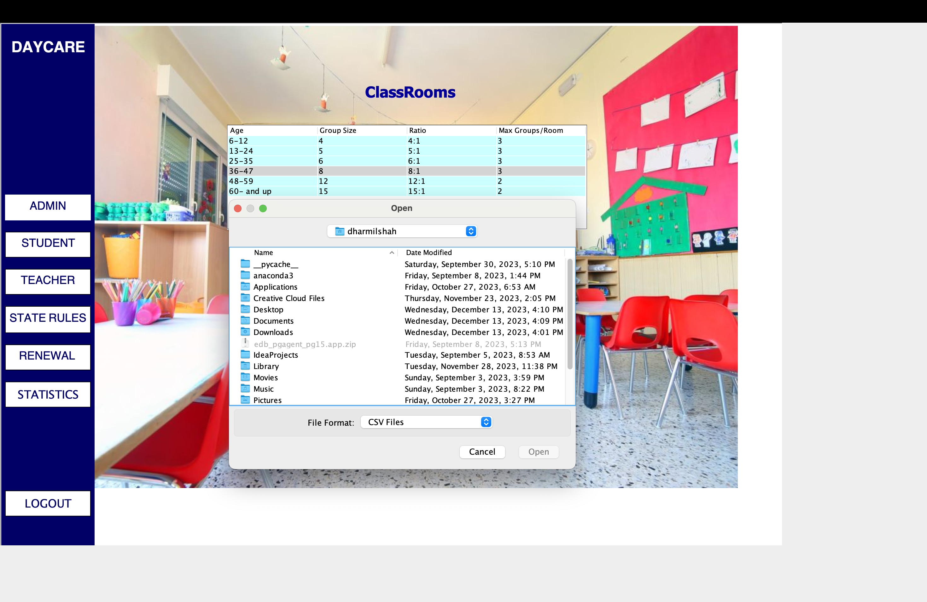
String of students can be uploaded from this option

Slide 10
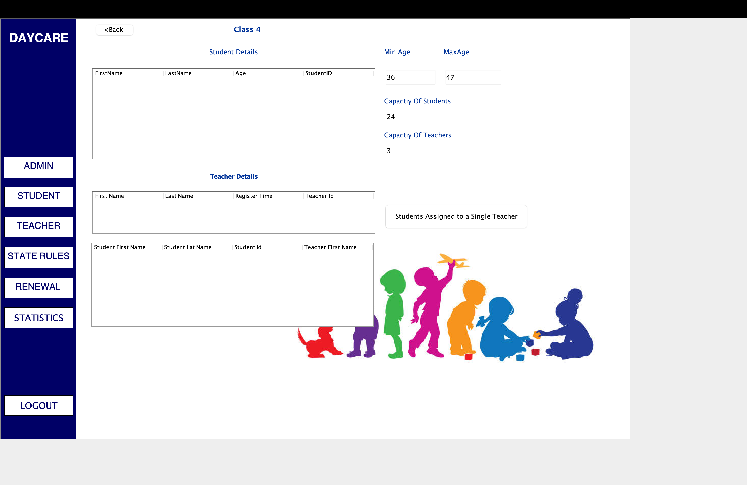
These are the class details only accessible to admin.

Slide 11
These are state immunization rules

Slide 12
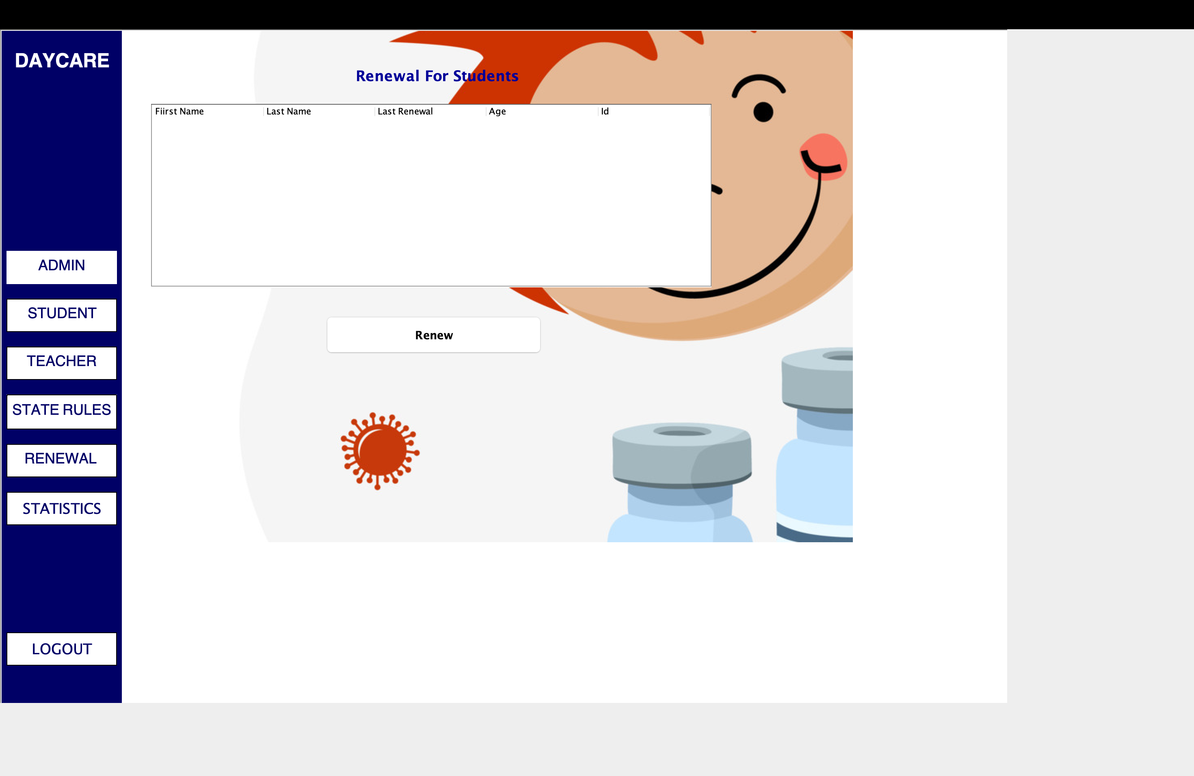
This is for tracking annual registration renewal

Slide 13
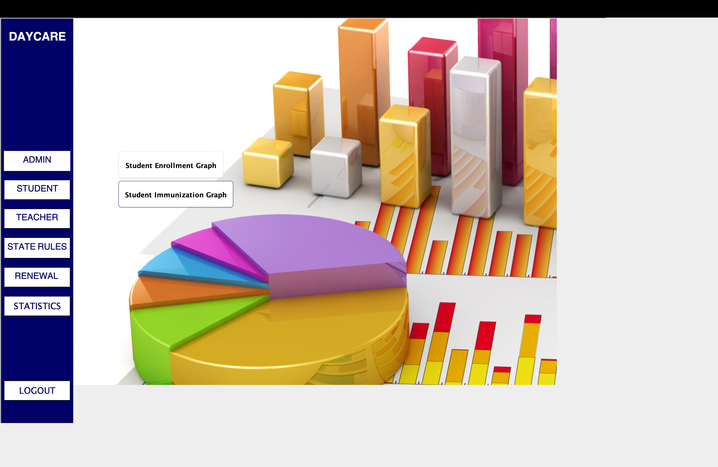
These is the statistics panel

Slide 14
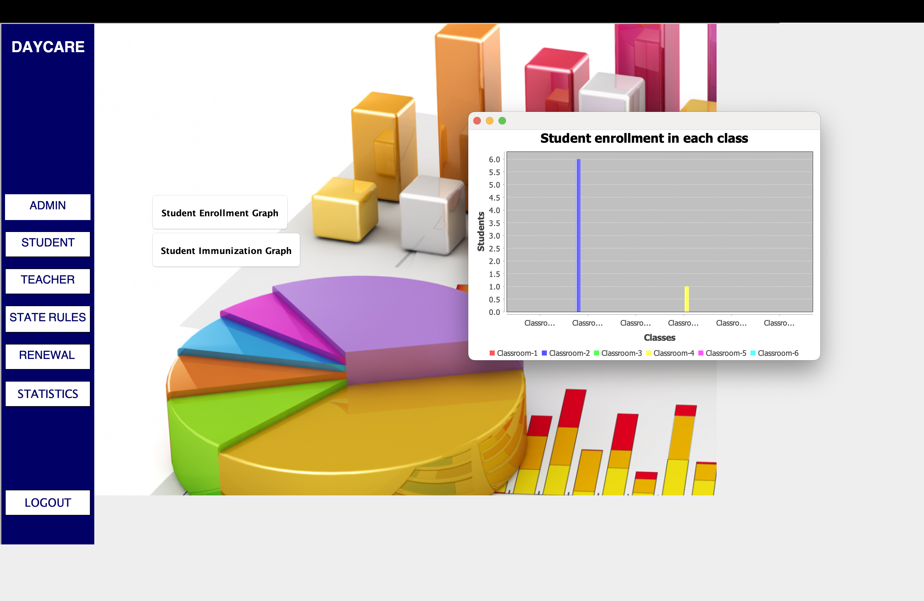
Statistics of students enrolled in each class

